Slide 1
EE227 – Digital Logic Design
Lecture 4 – 5

Slide 2
Outline
Complements of Numbers
Subtraction with complements
Signed Binary Numbers
Addition and subtraction in signed binary numbers
Binary Code
Binary Coded Decimal
Integer Arithmetic in BCD
Gray Code
ASCII Character Code
Binary Storage and Registers
Binary Logic
Logic Gates and Timing Diagrams

Slide 3
Complements of Numbers
Complements are used in digital computers to simplify the subtraction operation and for logical manipulation
Simplifying operations leads to simpler, less expensive circuits to implement the operations
There are two types of complements for each base‐r system
Radix complement (r’s complement)
Diminished radix complement (r – 1’s complement)

Slide 4
Diminished Radix Complement
Given a number N in base r having n digits, the (r - 1)’s complement of N , i.e., its diminished radix complement, is defined as (r^{n} - 1) – N
Which means, subtract each digit of the number from (r – 1)
For example the diminished radix complement of 546700 is calculated as
999999 – 546700 = 453299
In case of binary numbers it is called 1’s complement and is obtained by inverting all the bits
For example the 1’s complement of 11001 is 00110

Slide 5
Radix Complement
Radix complement is computed by adding 1 to the diminished radix complement
For example the r’s complement of 546700 is calculated as
999999 – 546700 = 453299 + 1 = 453300
In case of binary numbers it is called 2’s complement and can be calculated in two ways
Adding 1 to 1’s complement
By leaving all least significant 0’s and the first 1 unchanged and replacing 1’s with 0’s and 0’s with 1’s in all other higher significant digits
For example the 2’s complement of 1101100 is 0010100

Slide 6
Complements of Fractions
In the previous definitions, it was assumed that the numbers did not have a radix point
If the original number N contains a radix point, the point should be removed temporarily in order to form the r’s or (r - 1)’s complement
The radix point is then restored to the complemented number in the same relative position
It is also worth mentioning that the complement of the complement restores the number to its original value

Slide 7
Practice Problem 1
Find the (r – 1)’s complements of the following numbers
(23456)₈
(12004)₅
(03DBA)₁₆
(00110110)₂
(110111 . 1101)₂
Find the r’s complements of the following numbers
(11100010)₂
(00110011)₂
(89C2DF)₁₆
(042142)₅
(0723 . 6124)₈

Slide 8
Subtraction with Complements (1/2)
With Radix Complement
The subtraction of 2 n‐digit unsigned numbers M – N in base r can be done as follows:
Add M to the r’s complement of N
If M ≥ N then an end carry will be generated which can be discarded and the result will be M – N
If M < N, then there will be no end carry, and we have to compute the r’s complement of the sum to get the answer M – N, and place a negative sign with it
Example
Compute 72532 – 3250 and 3250 – 72532 by using r’s complement

Slide 9
Subtraction with Complements (2/2)
With (r – 1)’s Complement
The subtraction of 2 n‐digit unsigned numbers M – N in base r can be done as follows:
Add M to the (r – 1)’s complement of N
If there is an end carry, add it to the LSB of result
If there is no end carry, then compute the (r – 1)’s complement of the sum and place a negative sign with it
Example
If X = 1010100 and Y = 1000011
then find X – Y and Y – X by using (r – 1)’s complement

Slide 10
Practice Problem 2
For the given unsigned numbers perform the subtraction by using r’s complement and (r – 1)’s complement, then verify your answer by converting the numbers in decimal
(100010)₂ – (100110)₂
(43BD)₁₆ – (32A)₁₆
(73125)₈ – (23)₈
(23441)₅ – (400011)₅

Slide 11
Signed Binary Numbers (1/2)
In general there are two ways to represent signed binary numbers
Sign – Magnitude Method
MSB represents the sign and rest of the bits are used to represent the magnitude
If MSB is 1, the number is negative
If MSB is 0, the number is positive
For example 00001000 is +8 and 10001000 is -8
Complement method
1’s complement method
Number is represented by 1’s complement of its magnitude
2’s complement method
Number is represented by 2’s complement of its magnitude

Slide 12
Signed Binary Numbers (2/2)
Representations of +9 and -9 using 8 – bits
+9 has only one representation in binary
+9 = (0000 1001)₂
-9 has three representations
signed‐magnitude representation: 10001001
signed‐1’s‐complement representation: 11110110
signed‐2’s‐complement representation: 11110111
Signed 2’s complement method is used in computers

Slide 13
Why 2’s Complement Method is Used to Represent Signed Numbers?
We prefer 2’s complement method due to following reasons
With sign magnitude method we need to treat the sign bit and magnitude bits separately while performing arithmetic operations
In 1’s complement and sign magnitude method there are two representations of 0
In sign magnitude method every number must be represented as a signed number
Whereas in 2’s complement we only use 2’s complement if the number is negative

Slide 14
Arithmetic Addition in Signed Binary Numbers (1/2)
If we are using the sign-magnitude method then
If the signs are the same
We add the two magnitudes and give the sum the common sign
If the signs are different
We subtract the smaller magnitude from the larger and give the difference the sign of the larger magnitude
For example computing
(+13) + (+25)
(+13) + (-25)

Slide 15
Arithmetic Addition in Signed Binary Numbers (2/2)
If we are using the complement method then the procedure is simple
The addition of two signed binary numbers with negative numbers represented in signed‐ 2’s complement form is obtained from the addition of the two numbers, including their sign bits
A carry out of the sign‐bit position is discarded
For example lets compute the followings in binary
(+6) + (+13) (-6) + (+13)
(+6) + (-13) (-6) + (-13)

Slide 16
Arithmetic Subtraction in Signed Binary Numbers
For subtraction we prefer 2’s complement method
Take the 2’s complement of the subtrahend (including the sign bit) and add it to the minuend (including the sign bit)
A carry out of the sign‐bit position is discarded
(±A) – (+B) = (±A) + (–B)
(±A) – (–B) = (±A) + (+B)
Subtraction can be performed by using the circuit of adder

Slide 17


Ranges of Numbers
For a specific number of bits only a certain range of decimal numbers can be represented.
The maximum and minimum number can be found with the following relation
For unsigned numbers the range is
For Signed numbers the range is

Slide 18
Binary Codes (1/2)
Any discrete element of information that is distinct among a group of quantities can be represented with a binary code
A binary code is just a pattern of 0’s and 1’s
An n‐bit binary code is a group of n bits that assumes up to 2^{n} distinct combinations
Although the minimum number of bits required to code 2^{n} distinct quantities is n
There is no maximum number of bits that may be used for a binary code

Slide 19
Binary Codes (2/2)
There are many types of codes used in digital systems, some of them are
Binary Coded Decimal (BCD)
2421, excess 3, 8,4,-2,-1 codes
Gray Code
ASCII Character Code
Unicode
And many more

Slide 20
Practice Problem 3
What is the number of distinct code which can be generated by
4 bit long code
6 bits long binary code
10 bits long binary code
What are the minimum number of bits required if we want to code the following number of combinations
32 combinations
100 combinations
200 combinations
450 combinations

Slide 21
Binary Coded Decimal
BCD code is used to represent decimal numbers as a sequence of 0’s and 1’s
Each decimal digit is written in binary separately
For example the BCD code of 142 is 0001 0100 0010
A number with k decimal digits will require 4k bits in BCD
It is important to realize that BCD numbers are decimal numbers and not binary numbers, although they use bits in their representation

Slide 22
BCD Addition (1/2)
In BCD each digit cannot exceed 9, so with a possible carry the maximum sum is 9 + 9 + 1 = 19
The binary sum will produce a result in the range from 0 to 19
In binary, this range will be from 0000 to 10011, but in BCD, it is from 0000 to 1 1001
When the binary sum is equal to or less than 1001 (without a carry), the corresponding BCD digit is correct
When the binary sum is greater than 1001, the result is an invalid BCD digit
The addition of 6 = (0110)₂ to the binary sum converts it to the correct digit
This is because a carry in the most significant bit position of the binary sum and a decimal carry differ by 16 - 10 = 6

Slide 23
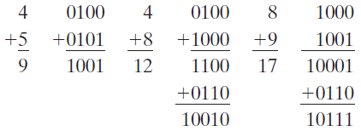
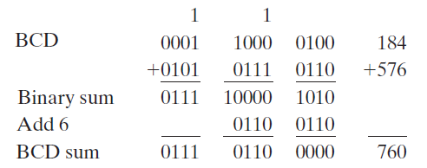
BCD Addition (2/2)
Perform the following BCD Additions
4 + 5
4 + 8
8 + 9
The addition of two n‐digit unsigned BCD numbers follows the same procedure with each digit added and corrected separately
For example 184 + 576 will be performed like this

Slide 24

BCD Subtraction
The representation of signed decimal numbers in BCD is similar to the representation of signed numbers in binary
The procedure developed for the subtraction of signed binary numbers is also applicable to BCD
For example 375 – 240 = 135 will be done like this

Slide 25
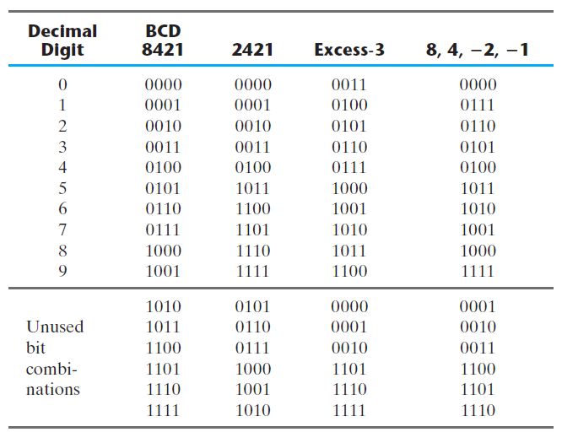
Other Decimal Codes

Slide 26
Practice Problem 4
Represent the unsigned decimal numbers 791 and 658 in BCD, and then show the steps necessary to form their sum
Formulate a weighted binary code for the decimal digits, using the 6,3,1,1 weights
Represent the decimal number 6,248 in
BCD
excess‐3 code
2421 code
6311 code

Slide 27
Gray Code
This coding system has a property that there is only one bit change between consecutive gray codes
The Gray code is used in applications in which the normal sequence of binary numbers generated by the hardware may produce an error or ambiguity during the transition from one number to the next
A typical application of the Gray code is the representation of analog data by a continuous change in the angular position of a shaft

Slide 28
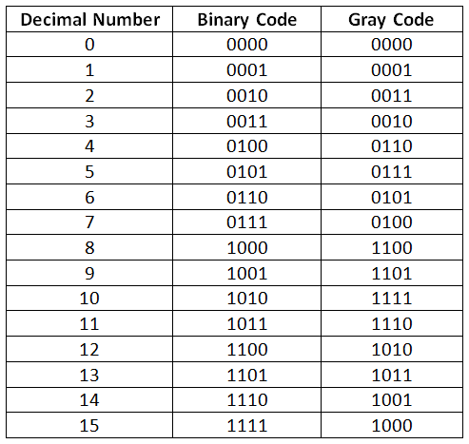
Gray Code Values

Slide 29
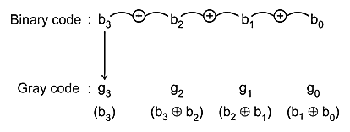
Generating Gray Codes from Binary
Start from Left
If it is MSB then place it as it is
Otherwise, Add the bit to the previous bit and place the sum in GRAY, ignoring any carry
Repeat step 2 till end
Write the gray code for the binary sequence 1010
The answer is 1111

Slide 30
Practice Problem 5
Convert the Binary Sequence (1001 0110)₂ to its equivalent gray code
The answer is 1101 1101

Slide 31
ASCII Character Code (1/2)
American Standard Code for Information Interchange (ASCII) is a 7 bit code which can be used for alphanumeric data
The 7 bits are designated through b₁ to b₇ with b₇ the MSB
There are 94 graphic characters (which can be printed)
Upper case and lower case letters, 0 – 9 digits and some special characters
And 34 non printing characters which are used for control purposes
ESC, SP, ACK, NAK etc

Slide 32
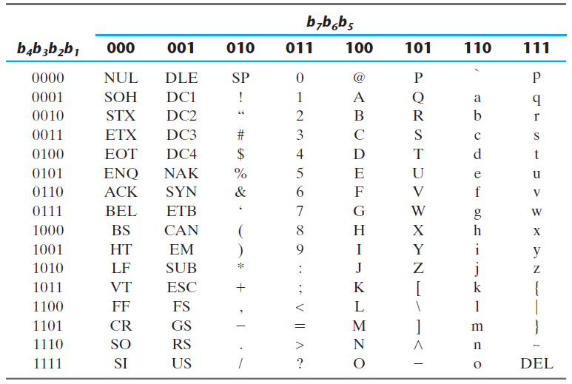
ASCII Character Code (1/2)

Slide 33

Error Detecting Code (1/2)
To detect errors in data communication and processing, an eighth bit is sometimes added to the ASCII character to indicate its parity
A parity bit is an extra bit included with a message to make the total number of 1’s either even or odd
In each case, we insert an extra bit in the leftmost position of the code to produce an even number of 1’s in the character for even parity or an odd number of 1’s in the character for odd parity
In general even parity is common
At the sender’s side the even parity is generated
And parity is checked at the receiving side

Slide 34
Error Detecting Code (1/2)
If the parity of the received character is not even, then at least one bit has changed value during the transmission
This method detects one, three, or any odd combination of errors in each character that is transmitted
An even combination of errors, however, goes undetected, and additional error detection codes may be needed to take care of that possibility
What is done after an error is detected depends on the particular application
One possibility is to request retransmission of the message on the assumption that the error was random and will not occur again
ASCII NAK and ACK are used by the receiver to indicate error and no error respectively

Slide 35
Binary Storage and Registers
The binary information in a digital computer must have a physical existence in some medium for storing individual bits
A binary cell is a device that possesses two stable states and is capable of storing one bit (0 or 1) of information
The input to the cell receives excitation signals that set it to one of the two states
The output of the cell is a physical quantity that distinguishes between the two states
The information stored in a cell is 1 when the cell is in one stable state
And 0 when the cell is in the other stable state

Slide 36
Registers
A register is a group of binary cells
A register with n cells can store any discrete quantity of information that contains n bits
The content of a register is a function of the interpretation given to the information stored in it
1100001111001001
The contents of above register are:
50,121 if simple binary number is considered
C and I if ASCII with even parity is considered

Slide 37
Register Transfer
In digital systems, a register transfer operation is a basic operation that consists of a transfer of binary information from one set of registers into another set of registers
The transfer may be direct, from one register to another, or may pass through data‐processing circuits to perform an operation
To process discrete quantities of information in binary form, a computer must be provided with devices that hold the data to be processed
The device most commonly used for holding data is a register

Slide 38
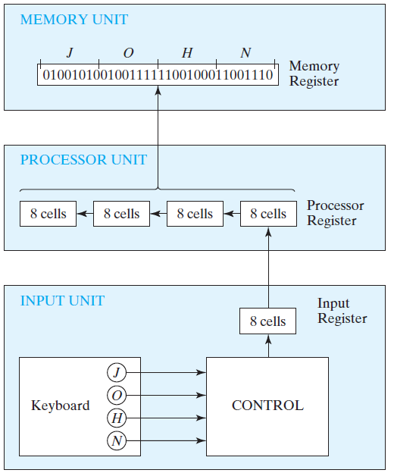
Transfer of Information from Keyboard to Memory Unit

Slide 39
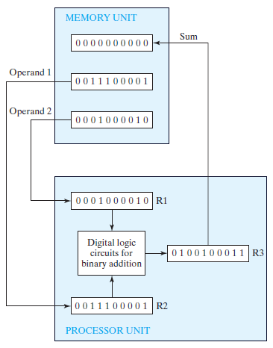
Binary Information Processing in Adding Two Numbers

Slide 40
Binary Logic
Binary logic deals with variables that take on two discrete values and with operations that assume logical meaning
The two values the variables assume may be called by different names (true and false, yes and no, etc.), but for our purpose, it is convenient to think in terms of bits and assign the values 1 and 0

Slide 41
Definition of Binary Logic (1/2)
Binary logic consists of binary variables and a set of logical operations
The variable have two and only two distinct possible values: 1 and 0
There are three basic logical operations: AND, OR, and NOT. Each operation produces a binary result, denoted by z
AND
This operation is represented by a dot or by the absence of an operator
For example x.y = z or xy = z both will be read as x AND y is equal to z
The logical operation AND is interpreted to mean that z = 1 if and only if x = 1 and y = 1; otherwise z = 0

Slide 42
Definition of Binary Logic (2/2)
OR
This operation is represented by a plus sign. For example, x + y = z is read “x OR y is equal to z”
Meaning that z = 1 if x = 1 or if y = 1 or if both x and y are 1
If both x = 0 and y = 0, then z = 0
NOT
This operation is represented by a prime (sometimes by an overbar). For example, x’ = z (or x = z ) is read “not x is equal to z,” meaning that z is what x is not
In other words, if x = 1, then z = 0, but if x = 0, z = 1

Slide 43
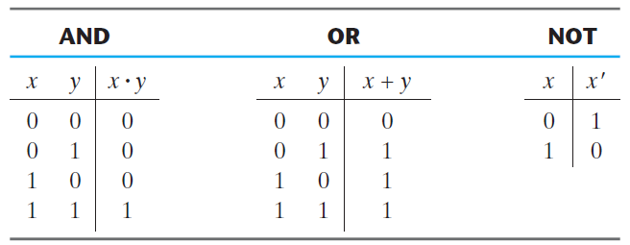
Truth Table
A truth table is a table of all possible combinations of the variables, showing the relation between the values that the variables may take and the result of the operation
Truth tables of AND, OR and NOT are shown below

Slide 44
Binary Arithmetic and Binary Logic
Binary logic resembles binary arithmetic, and the operations AND and OR have similarities to multiplication and addition, respectively
In fact, the symbols used for AND and OR are the same as those used for multiplication and addition
However, binary logic should not be confused with binary arithmetic
One should realize that an arithmetic variable designates a number that may consist of many digits. A logic variable is always either 1 or 0
For example, in binary arithmetic, we have 1 + 1 = 10 (read “one plus one is equal to 2”), whereas in binary logic, we have 1 + 1 = 1 (read “one OR one is equal to one”)

Slide 45
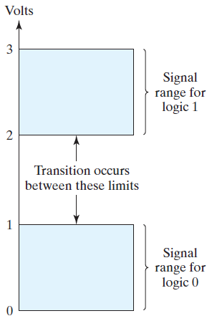

Logic Gates
Logic gates are electronic circuits that operate on one or more input signals to produce an output signal
The voltages and currents are continuous
The inputs of gates must be digital
The conversion from analog to digital is done through defined voltage/current levels
For example the values greater than a specific threshold will be treated as 1 and values less than that specific threshold are treated as 0
The graphical symbols of three gates are also shown below

Slide 46
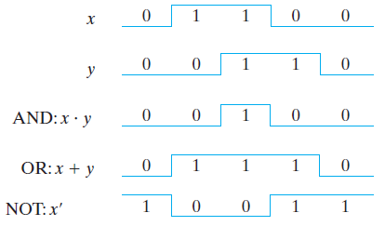
Timing Diagrams
The timing diagrams illustrate the idealized response of each gate
The horizontal axis of the timing diagram represents the time, and the vertical axis shows the signal as it changes between the two possible voltage levels

